Slide 1
TNSDC –Generative AI FOR ENGINEERING FINAL PROJECT
SUBMITTED BY:
K.HARINI
REG NO:311521104701

Slide 2
PROJECT TITLE:
“MUSIC GENERATION USING LSTM”

Slide 3
agenda
Problem statement
Project overview
End users
Value proposition
Solution
Modelling
Results

Slide 4
Problem statement
Develop an LSTM-based music generation system to create original MIDI compositions. Utilize a dataset of MIDI files, preprocess the data, and design an LSTM model capable of learning sequential patterns. Train the model, generate new musical sequences, and evaluate their quality. Iterate on the model architecture and generation techniques to enhance the creativity and coherence of the generated music.

Slide 5
Project overview
Introduction:
In an era where AI intersects with creativity, the ability to generate music autonomously has captivated both musicians and technologists alike. Leveraging the power of LSTM neural networks, this project endeavors to explore the realm of AI-generated music, culminating in the creation of original compositions.

Slide 6
Project overview
Objectives:
Data Collection: Gather a diverse dataset of MIDI files containing musical compositions across various genres and styles.
Data Preprocessing: Extract meaningful sequences of musical notes and chords from the MIDI dataset, preparing it for model training.
Model Design: Develop an LSTM-based neural network architecture capable of learning sequential patterns inherent in the MIDI data.
Model Training: Train the LSTM model using the preprocessed MIDI dataset to learn the complex patterns and structures of musical compositions.
Music Generation: Implement a function to generate new musical sequences using the trained LSTM model, allowing for the creation of original compositions.
Evaluation: Assess the quality and creativity of the generated music using qualitative and quantitative metrics, comparing it to the original dataset.
Refinement: Iterate on the model architecture, training process, and generation techniques based on evaluation feedback to enhance the quality and diversity of the generated music.

Slide 7
Project overview
Expected Outcome:
This project is a functional LSTM-based music generation system capable of autonomously creating original MIDI compositions. The generated music should exhibit creativity, coherence, and stylistic elements reflective of the input dataset, showcasing the potential of AI in artistic expression.

Slide 8
Value proposition
"Our project aims to democratize music creation by harnessing the power of artificial intelligence. By developing an LSTM-based music generation system, we provide musicians and enthusiasts with a tool to effortlessly produce original compositions. With its ability to learn from diverse musical styles and structures, our system offers a unique avenue for creative exploration, enabling users to unleash their artistic potential and push the boundaries of music composition.”
"

Slide 9
End users
The end users of the Music Generation System are -
Musicians: Professional and amateur musicians seeking inspiration or assistance in composing new music.
Music Producers: Individuals involved in music production looking for innovative tools to enhance their creative process.
Educators: Music teachers and instructors interested in integrating AI-based music generation into their curriculum to engage students and explore new teaching methods.
Hobbyists: Enthusiasts passionate about music who enjoy experimenting with AI technology to create original compositions for personal enjoyment or sharing with others.

Slide 10
solution
Our solution entails the development of a sophisticated LSTM-based music generation system. Leveraging deep learning techniques, we preprocess a diverse dataset of MIDI files to extract sequential patterns of musical notes and chords. Subsequently, we design and train an LSTM neural network architecture capable of learning these patterns and generating original compositions.
Upon training the model, users can employ our intuitive interface to generate new musical sequences with ease. The system harnesses the learned patterns from the training data to produce coherent and stylistically consistent compositions. By offering adjustable parameters for creativity control, such as temperature sampling, users can tailor the generated music to suit their preferences. Additionally, our system provides real-time feedback on the generated compositions, enabling users to iterate and refine their creations effortlessly.

Slide 11
Modelling
The modelling approach for Music Generation System is as follows:
Data Preprocessing: Extract and preprocess MIDI data, converting it into a suitable format for model input.
Model Architecture Design: Design an LSTM-based neural network architecture capable of learning sequential patterns from the preprocessed MIDI data.
Training Data Split: Split the preprocessed MIDI dataset into training, validation, and testing sets to facilitate model training, validation, and evaluation.
Model Training: Train the LSTM model on the training data using appropriate loss functions, optimizers, and training parameters.
Music Generation: Implement a function to generate new musical sequences using the trained LSTM model.
Evaluation: Evaluate the quality of the generated music using qualitative and quantitative metrics, including musicality, coherence, and similarity to the original dataset.

Slide 12
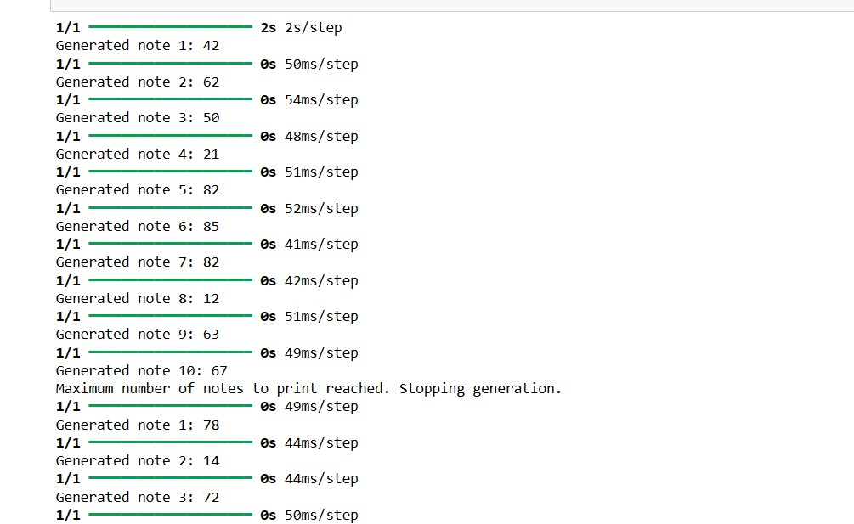
results
The project culminates in a sophisticated LSTM-based music generation system capable of autonomously creating original MIDI compositions. The system successfully captures the stylistic elements and structural patterns present in the input dataset, producing diverse and coherent musical sequences that showcase the potential of AI in artistic expression.The sample output of the implementation is as follows:

Slide 13
Thank you
Project link:
https://github.com/HariniK0307/GenAINaanMudhalvan

